Slide 2



Francesco Lacriola
Software Eng. – Senior Analyst
Daniele Gallitelli
Software Eng. – Senior Analyst
Michele Caccia
Senior Software Eng. – Senior Consultant

Slide 3
What we’ll do today
Introduction to Apache Kafka
Build a real world, multi-service event-driven system
  Simulates a fleet of trains sending real-time location data
  Processes data to generate insights
  Visualizes everything on a live dashboard
  Uses multiple programming languages (Java & Python)
Q/A

Slide 4

What is Apache Kafka
Distributed streaming platform for building real-time data pipelines
  Originally developed by LinkedIn, now open-source (Apache)
  High-throughput message broker, allowing systems to publish, store, and consume streams of records in a fault-tolerant and scalable way
  Durable storage — Data is persisted on brokers disk, allowing replay and recovery.
Key Features
High throughput & low latency
Fault-tolerant & scalable
Persistent storage
Real-time processing

Slide 5
What is Apache Kafka
Source System
Source System
Source System
Source System
Source System
Data
Data
Data
Data
Data
Target System
Target System
Target System
Target System
Target System

Slide 6

What is Apache Kafka
Source System
Source System
Source System
Source System
Target System
Target System
Target System
Target System

Slide 7
Where is Kafka used
Used by 2000+ firms, 80% of Fortune 100
SBB: Yes — we use Kafka too! (Master Data propagation, connected train telemetry and real-time services)
Netflix: Real-time recommendations & monitoring
Uber: Real-time pricing, trip tracking
LinkedIn: Activity streams, operational metrics
PayPal: Risk detection, fraud prevention
Banking: Transaction processing, fraud detection
E-commerce: Inventory management, order processing

Slide 8
Topics: Your Data Channels
Topic = A particular stream of data published in your Kafka Cluster
Like a table in a database or a folder in a filesystem
Topics are multi-subscriber (many applications can read the same topic)
A topic is identified by its name
It is impossible to query topics. Use Kafka Producers to send data and Kafka Consumers to read the data
Examples in our workshop:
train-locations - raw position data from trains
train-speed-averages - processed speed analytics
Kafka Broker
logs
train-locations
train-speed
average

Slide 9
Partitions and offsets
Each topic is divided into partitions
Partitions allow parallel processing
Messages in a partition can be ordered
Each message has an offset (sequential ID)
Kafka topics are immutable
Our train-locations topic has 3 partitions
Partition 0
0
1
2
3
4
5
6
Kafka Topic
Partition 1
0
1
2
3
4
5
Partition 2
0
1
2
3
4
5
6
Topic: train-locations
├── Partition 0: [msg0, msg3, msg6, ...]
├── Partition 1: [msg1, msg4, msg7, ...]
└── Partition 2: [msg2, msg5, msg8, ...]

Slide 10
Producers: Publishing Data
Applications that publish (write) records to topics
Specify which partition to send to (and which Kafka broker has it)
Can use keys for consistent routing
In our workshop: TrainLocationSimulator (Java)
Partition 0
0
1
2
3
4
5
6
Kafka Producer
Kafka Topic
Partition 1
0
1
2
3
4
5
Partition 2
0
1
2
3
4
5
6
Example:
Train T-123 → partition based on train ID → always same partition
This ensures all messages from the same train stay in order!

Slide 11
Consumers: Reading Data
Applications that subscribe to topics and process records (pull model)
Maintain an offset to track what they've read -> Consumers know which broker to read from
Can rewind and replay messages
In our workshop:
SpeedAnalysisStream (Kafka Streams)
DashboardWebApp (Java)
MaintenanceAlerter (Python)
P0
0
1
2
3
4
5
6
Kafka Consumer
Kafka Producer
Kafka Topic
P1
0
1
2
3
4
5
Kafka Consumer
P2
0
1
2
3
4
5
6

Slide 12
Consumer Groups: Teamwork!
Multiple consumers working together as a group
Each partition assigned to only one consumer in the group
Enables parallel processing and load balancing
If a consumer fails, its partitions are reassigned → fault tolerance
P0
P1
P2
C1
C2
C3
C4
consumer-group-1
Benefits:
Same group = share the workload
  Different groups = each gets all messages
Zero message loss
P0
P1
P2
C1
C2
C1
C2
C3
consumer-group-1
consumer-group-2
notification service
train-location service

Slide 13

Schema Registry
Apache Kafka doesn’t validate data streams
  What if a producer sends bad data?
  What if a field gets renamed?
  What if the data format changes from one day to another?
consumers breaks!
Schema Registry
send schema
receive schema
validate
Source
Target
Producer
Consumer
avro
avro

Slide 14
Apache Avro
Data Serialization Framework
Schema Evolution
efficient, compact, binary format
backward & forward compatibility
Readability
Schema-based
schema readable (JSON)
Data is not (binary)
JSON-defined schemas & ensures data consistency

Slide 15
Kafka vs RabbitMQ/ActiveMQ 🥊
Kafka Advantages:
✅ Higher throughput (millions of msgs/sec)
✅ Persistent storage (replay capability)
✅ Horizontal scalability
✅ Built for streaming & big data
Traditional Messaging:
❎ Complex routing (exchanges, bindings)
❎ Lower latency for small messages
❎ Message priority queues
❎ Simpler request/reply patterns
When to use Kafka:
📌High volume event streaming
📌 Log aggregation
📌 Real-time analytics
📌 Event sourcing

Slide 16
Our Workshop Architecture 🏗️
Services:
Producer: TrainLocationSimulator (Java) - generates train positions
Maintenance Alerter: MaintenanceAlerter (Python) - slow train alerts
Dashboard Consumer: TrainConsumerDashboard (Java) - Demonstrates partition rebalancing
Stream Processor: SpeedAnalysisStream (Java, Kafka Streams) - calculates averages
WebSocket Dashboard: TrainWebsocket (Java, WebSocket) - real-time visualization
All connected through Kafka topics! 🔄

Slide 17

Our Workshop Architecture: topic train-locations🏗️
SpeedAnalysisStream
TrainLocationSimulator
train-locations
MaintenanceAlerter
TrainConsumerDashboard

Slide 18
Our Workshop Architecture: topic train-speed-averages🏗️
SpeedAnalysisStream
train-locations
TrainWebsocket
train-speed-averages

Slide 19
Kafka is Language Agnostic 🌐
Any language can produce/consume from Kafka:
☕ Java (most common, best support)
🐍 Python
🟨 JavaScript/Node.js
🔵 Go
🟣 C#/.NET
And many more...
Workshop Demonstration:
✅ Java producers and consumers
✅ Python consumer (maintenance alerter)
✅ Both read from the same topic seamlessly

Slide 20
Kafka Streams 🔄
Library for building stream processing applications
Processes data as it arrives (real-time)
Supports transformations, aggregations, joins, windowing
No separate cluster needed
Our Use Case:
Read from train-locations
Calculate average speed per train (10-second window)
Write to train-speed-averages

Slide 21
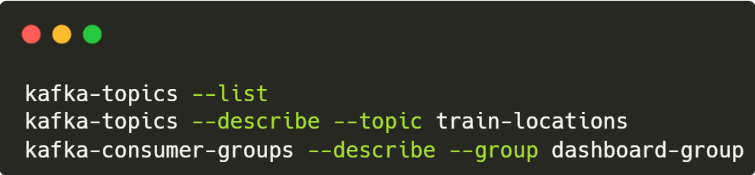
Kafka Monitoring Tools 📊
Command Line Tools:
Web Interface:
  Kafka UI (localhost:8099, shipped with our containers🎉)
    Monitor topics, partitions, consumer groups
    View messages in real-time
    Track consumer lag
  RedPanda
  … and many more!

Slide 22
Common Patterns
Event Sourcing
🧾 Store every change to application state as an immutable sequence of events.
🧩 Kafka acts as the event log — a single source of truth.
⏳ Enables time-travel debugging, replay, and rebuilding state at any point.
CQRS (Command Query Responsibility Segregation)
✍️ Separate commands (writes) from queries (reads) for scalability and clarity.
💡 Kafka Streams can manage the write-side events, while materialized views serve reads.
⚖️ Perfect for systems with uneven read/write loads.

Slide 23
Common Patterns
Data Pipelines
🔗 Kafka connects producers and consumers in real-time data flow.
⚙️ Simplifies ETL: ingest → process → distribute, no batch delays.
📊 Powers streaming analytics and long-term data storage.
Microservices Communication
📨 Kafka decouples services with asynchronous, event-driven messaging.
🧠 Reduces reliance on REST calls, improving resilience and fault tolerance.
🌱 Promotes loose coupling and scalable architecture.

Slide 24
Production Best Practices 🎯
Design:
📦 Use shared libraries for data models (avoid duplication)
🗄️ Schema Registry for data contracts (Avro, JSON Schema)
    📌Check avro services in the repository for more!
🔄 Version your message formats
🎯 Use message keys for partitioning logic (same key = same partition)
⚡ Configure appropriate retention policies
Execution:
📊 Monitor consumer lag
⚖️ Right-size partition count
🔒 Enable authentication & encryption (production)
💾 Configure replication factor
🧪 Test rebalancing scenarios

Slide 25
Hands-On Time! 🛠️
What You'll Do:
✅ Set up Kafka infrastructure (Docker)
✅ Start the train location producer
✅ Run the stream processor
✅ Launch the WebSocket dashboard
✅ Add Python maintenance alerter
✅ Test partition rebalancing with scaling
Prerequisites check:
🐳 Docker & Docker Compose
If you want to build and run it yourself:
☕ Java JDK 17+ • 🔨 Maven • 🐍 Python 3.8+

Slide 26
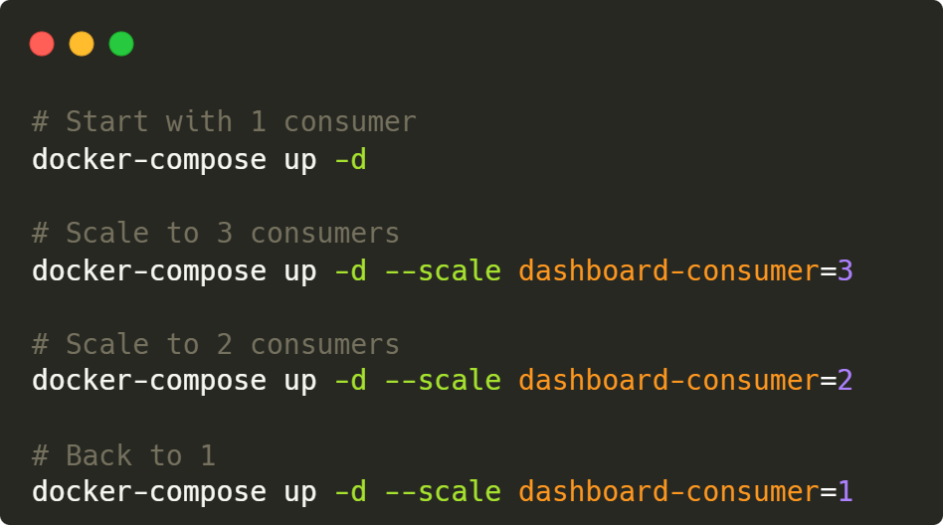
Partition Rebalancing in Action ⚖️
Live Scaling Demo:
Watch: Partition reassignment • Rebalancing events • Zero message loss

Slide 27
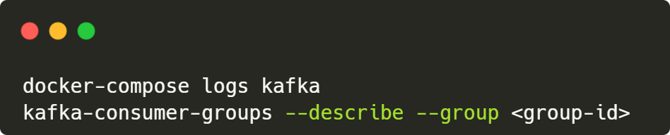
Avoiding Common Mistakes ⚠️
Top Issues:
🔌 Connection refused: Kafka not running → docker ps
🔄 Deserialization errors: Mismatched serializers
📈 Consumer lag: Too few consumers for partition count
🔑 Wrong consumer group: Competing consumers
🕐 Offset reset issues: Check auto.offset.reset config
Debug Commands:

Slide 28
Continue Your Kafka Journey 🚀
Deep Dive Topics:
📊 Advanced Kafka Streams (joins, state stores)
🔒 Security (SSL, SASL, ACLs)
🌍 Multi-datacenter replication
⚡ Performance tuning
🗄️ Schema evolution strategies
Learning Resources:
📚 Confluent Documentation
📖 "Kafka: The Definitive Guide" (O'Reilly)
🎓 Confluent Developer courses
🐙 Apache Kafka official docs

Slide 29

Q/A

Slide 30
Thank You!
Workshop repository: GitHub
Call to Action:
Star the repository
Try building your own use case
Share your experience
Happy Streaming!

